Slide 1


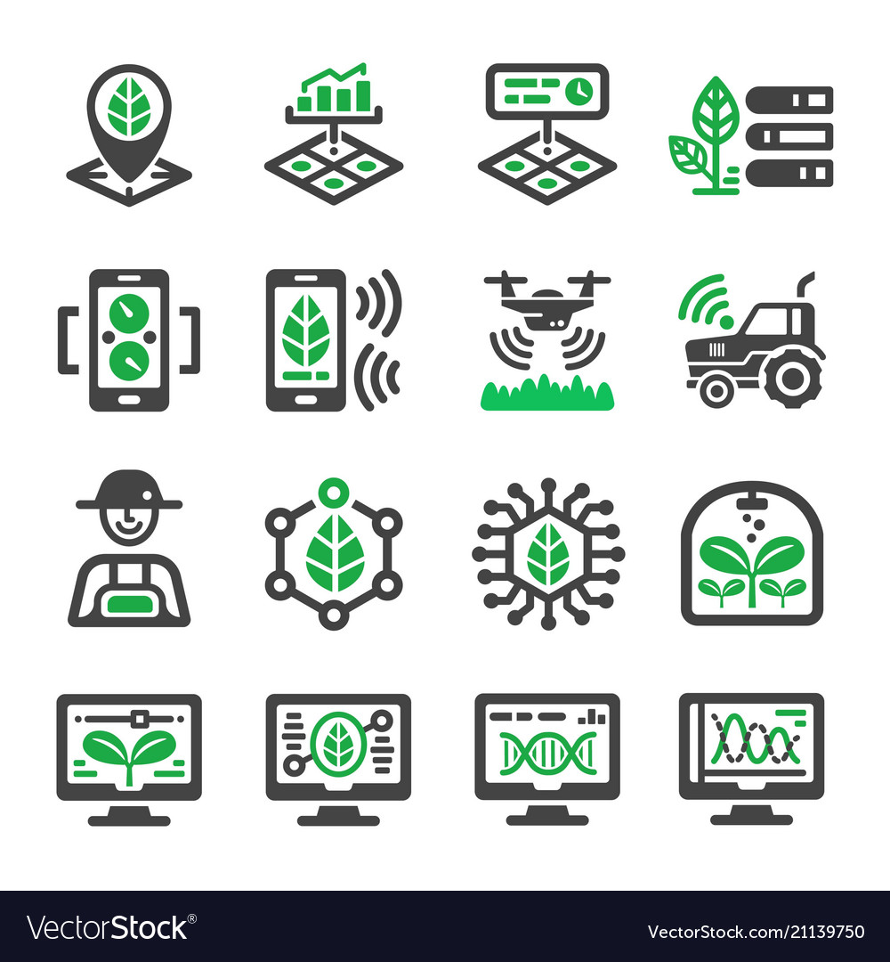
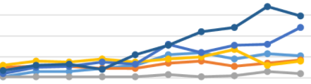
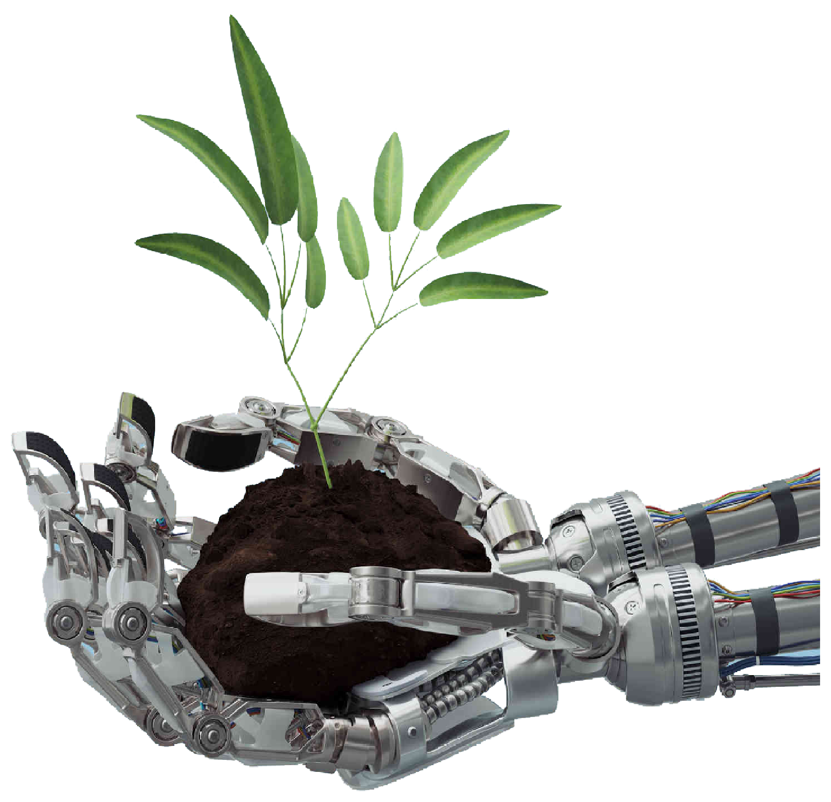
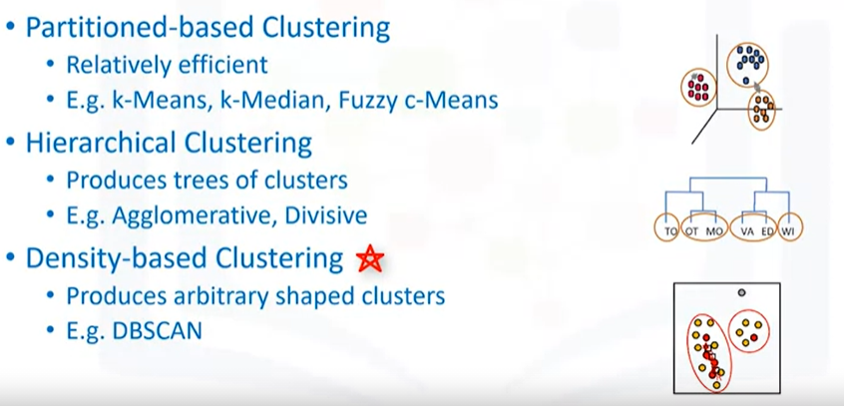
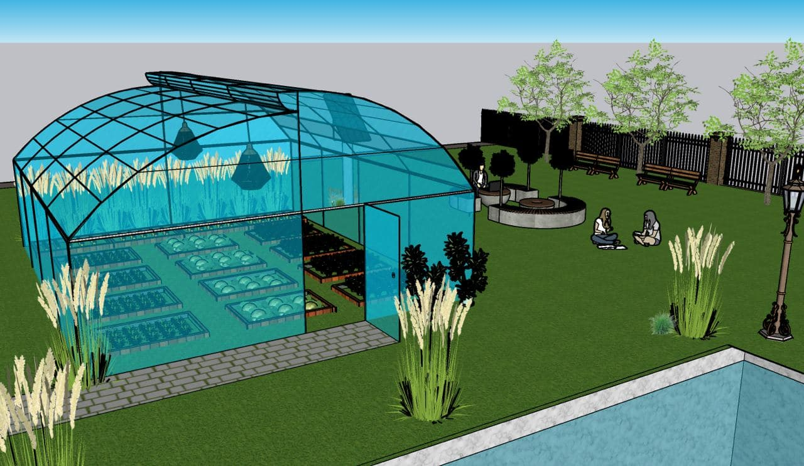
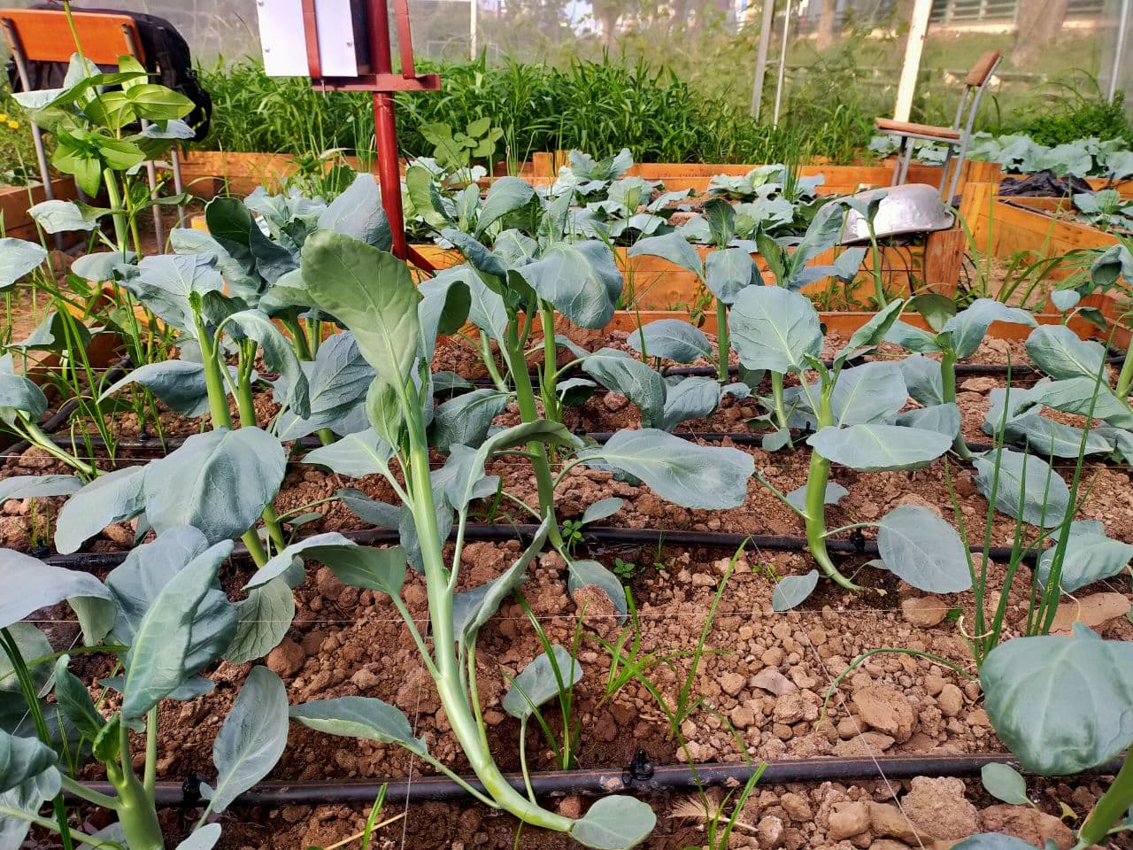
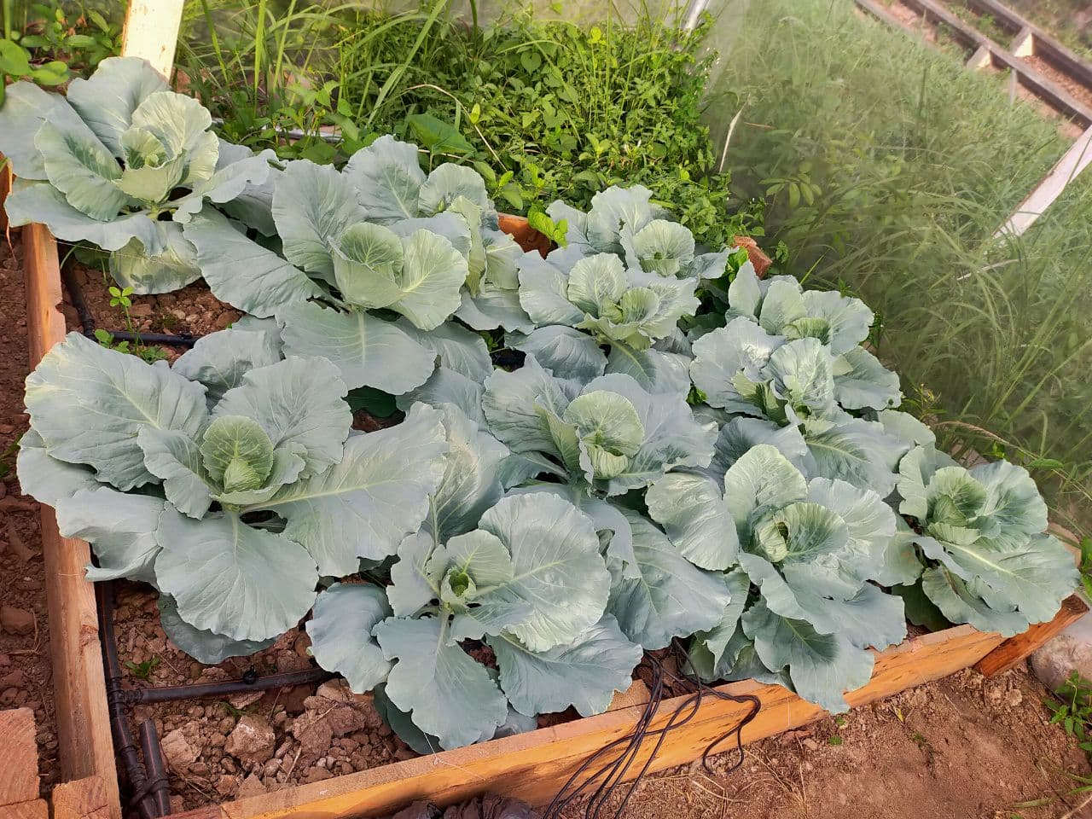
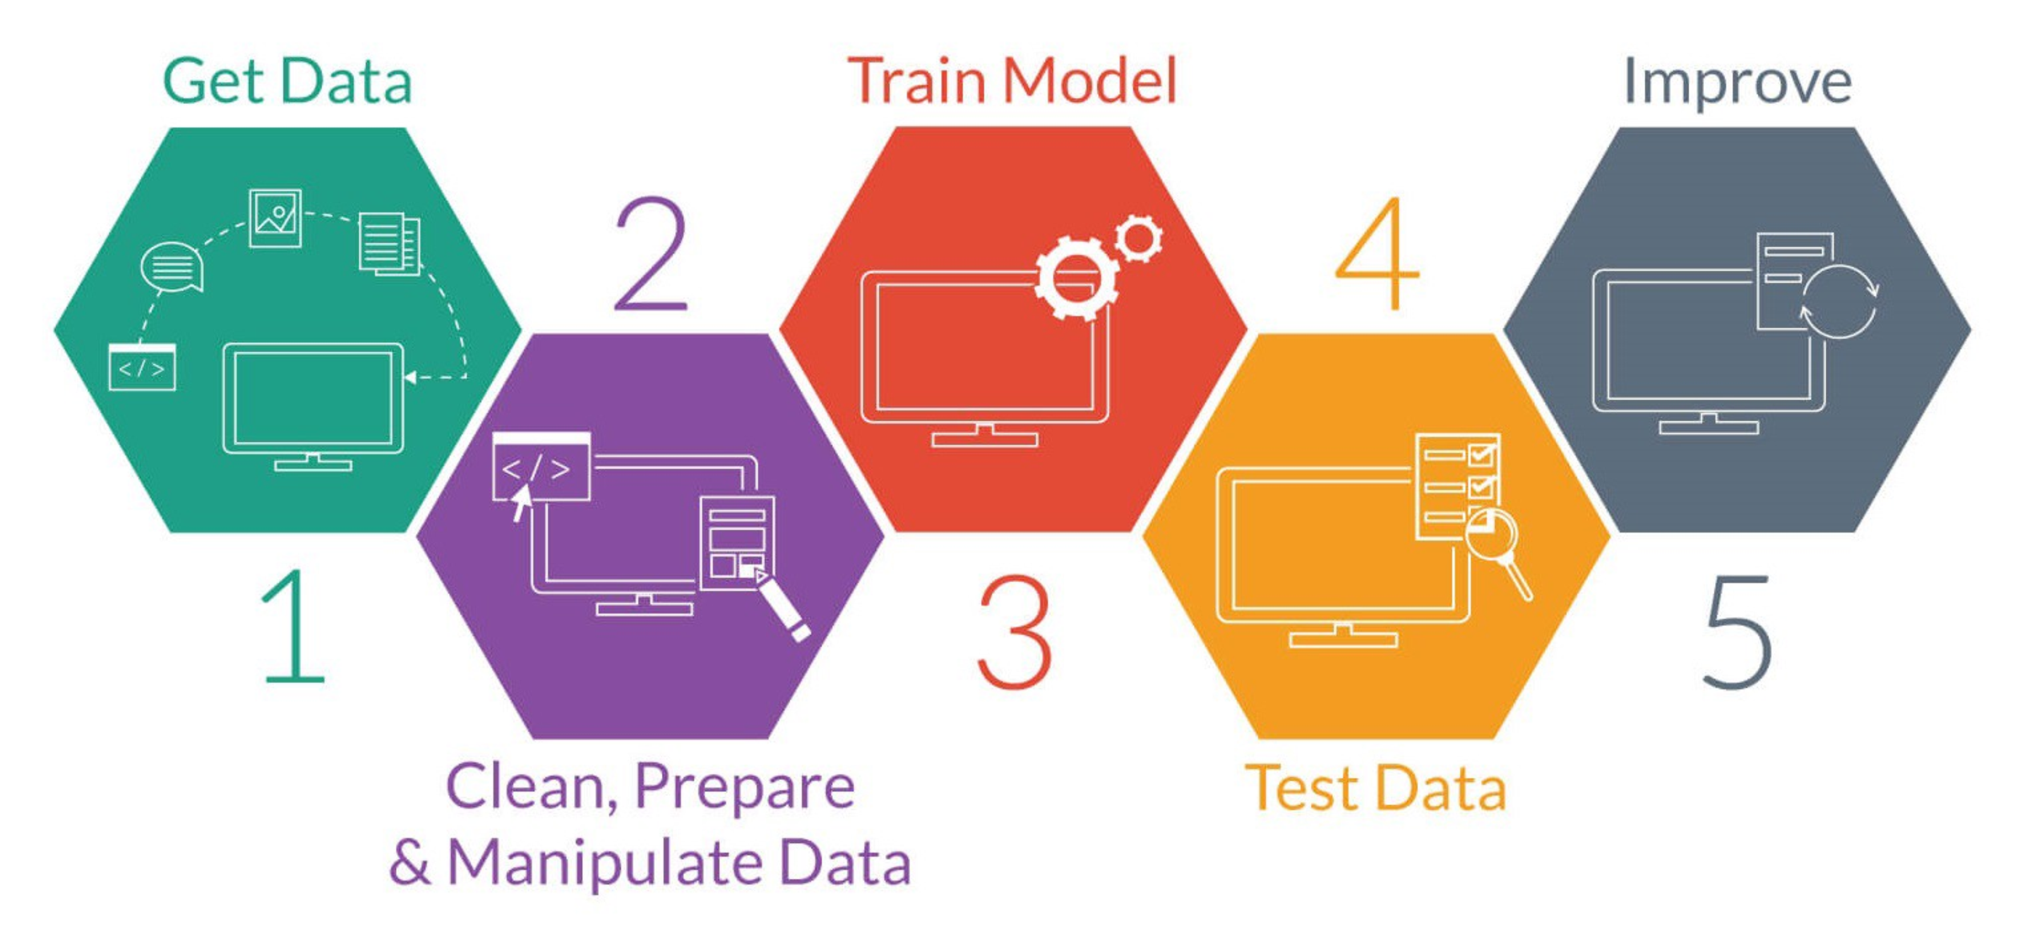
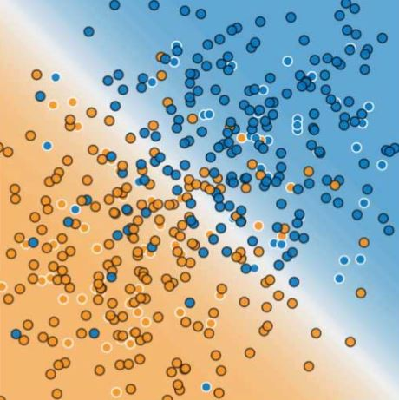
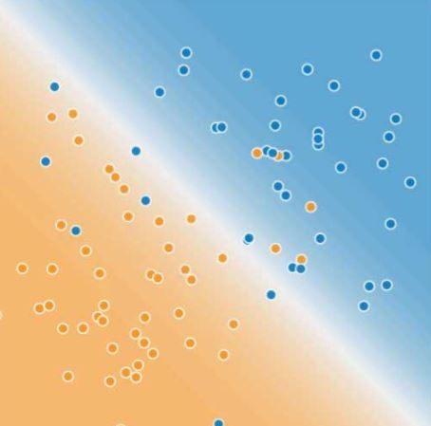
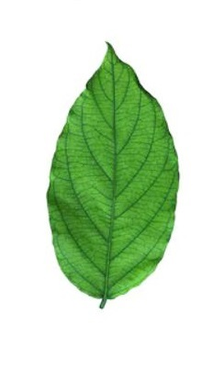
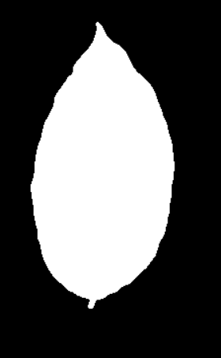
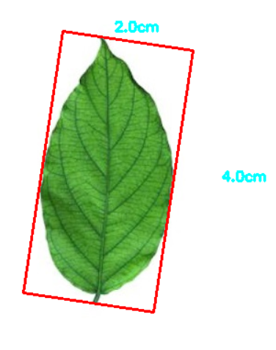
IOT PLATFORMS FOR SMART IRRIGATIONS
“AI FOR AGRICULTURE”
ADVISOR : HEL CHANTHAN
STUDENT : CHEK NITA
INTRODUCTION
Train Data and Test Data
Make Prediction and improve the systems
MODELING
Agriculture and farming is one of the oldest and most important professions in the world. Humanity has come a long way over the millennia in how we farm and grow crops with the introduction of various technologies. Artificial intelligence (AI) is one of the most modern application that has been used all around the world in this industrial revolution 4.0. With the aid of AI in agriculture, we can build the most modern and convenience ways to apply
and estimate data analytic for agricultural
applications that boost more production yield.
Objective of this work is to apply AI to predict the crop yield according to environmental data and crop growing pattern.
From the data/image that has been pre-processed, The data(s) will be apply ML techniques depend on its specific needed.
Example Data Graph
Data
Sets
DATA COLLECTION
Apply ML
Techniques
b. Smart Farm
f. Data sets
g. Data after
modeling
TRAIN & TEST
Plant (a)
Before proceed into the results ,The data(s) will be process into training and testing for detect its accuracies and its errors.
For the testing parts , new data(s) will be use to test by comparing with the trained data(s).
Necessary information such environmental data, crop pattern images, crop yield will be collected from the farm and stored in the cloud.
SYSTEM
ARCHITECTURE
Plant (b)
PRE-
PROCESSING
Before getting start into Machine Learning ( AI ) , We need to pre-processing the data/image that we have been collected to make it convenient for next step.
h. Training Data
i. Test Data
RESULTS
a. System Architecture
By applying the AI into the agriculture applications we get :
- Convenience to control the data
- Emphasis on checking defective
crops and improving the potential for healthy crop production.
Collect Data from Cloud storage
Clean and Prepare data and collect only study area
Use the filtration data and apply machine learning techniques to make an analysis
c. Sample leaf
d. Leaf after filter
e. Detected
size leaf

